Slide 1
Simplified forms of costs

Slide 2
Breakdown of contents
I: Simplified forms of costs
Which ones?
Why?
II: Horizon Europe Implementation strategy online consultation
III: The Lump sum pilot
Why?
A pilot with 2 options
Principles
Lessons learned

Slide 3
Horizon Europe -
Simplified forms of costs

Slide 4
Simplified forms of costs
Different simplified forms:
Units
Lump sums
Flat rate
One common two-fold objective:
Reducing the administrative burden & the risk of errors

Slide 5
Why simplified forms?
Focus on conditions triggering the payment
Shift from focus on financial management and checking costs to focus on scientific-technical content of the projects, e.g.:
For unit: occurrence of an event, achievement of a deliverable or a specific output etc…
For lump sum: e.g. performance of a set of activities (e.g. accomplishment of a Work Package).

Slide 6
Record-keeping for beneficiaries
They need
Technical documents
Publications, prototypes, deliverables
…any document proving that the work was done
They don't need
Time-sheets
Pay-slips
Depreciation policy
Invoices
…any document proving the actual costs incurred
Who did what?
Already the case for actual costs-based MGA

Slide 7
Examples of usage
Actual costs
e.g. Personnel costs, other direct costs, subcontracting etc.
Unit costs
e.g. SME owner unit cost, MSCA unit costs
Lump sum
All types of costs (i.e. H2020 lump sum pilot)
Flat rates
e.g. Indirect costs (25%)

Slide 8
Horizon Europe Implementation strategy online consultation

Slide 9
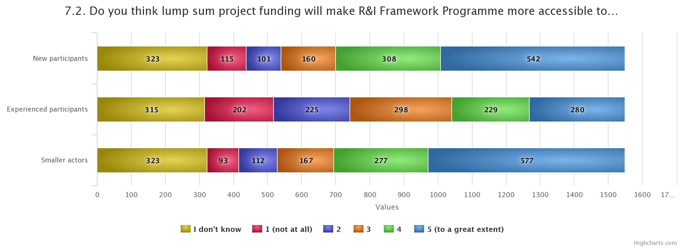
Stakeholders contribution to Horizon Europe Co-design
Results of the on-line consultation
55% consider it will be more accessible for newcomers
55% consider it will be more accessible for smaller actors
33% consider it will be more accessible experienced participants
Similar pattern from Bulgarian and Romanian respondents

Slide 10
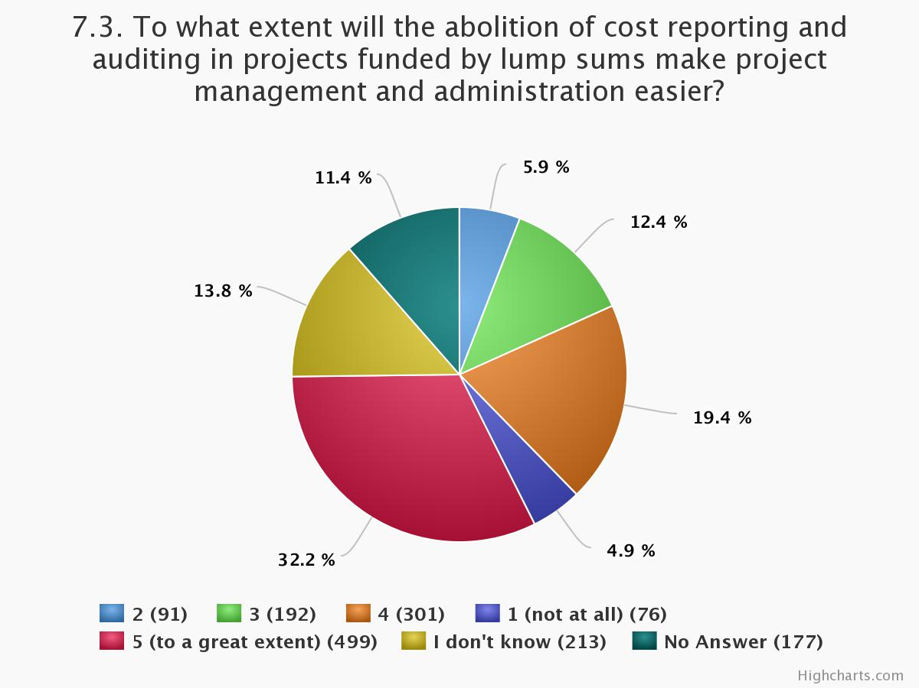
Stakeholders contribution to Horizon Europe Co-design
Results of the on-line consultation
52% consider management and administration will be easier
11% consider management and administration will be more complicated
Similar pattern for Bulgarian and Romanian respondents

Slide 11
Lump sum Pilot

Slide 12
Lump sum: Why?
Significant simplification potential:
Despite all simplification, funding based on reimbursement of incurred costs stays complex and error-prone
Lump sum project funding removes all obligations on actual cost reporting and financial ex-post audits – i.e. a major reduction of administrative burden
Focus on performance:
Shift from focus on financial management and checking costs to focus on scientific-technical content of the projects

Slide 13
Lump sum pilot – Two options
Amount of the lump sum
Fixed in the Call
Per project
based on the budget

Slide 14
Lump sum pilot – Two options
Option 1
Fixed lump sum per project defined in call for proposals
Proposals describe the efforts and resources applicants commit to mobilise for this amount.
Applicants must provide proposed split of the lump sum per work package and per beneficiary.
The evaluation – and competition between proposals – ensure that adequate resources are committed
Option 2
Proposals provide a detailed estimation of costs
Experts assess cost details during evaluation and make recommendations (panel will include expert/s with financial expertise).
Based on this, the lump sum is fixed during grant preparation

Slide 15
Principles
Lump sum evaluation and grant agreement follow standard approach as much as possible:
Same evaluation criteria
Same pre-financing and payment scheme
Reporting periods and technical reporting as today, though focusing on completion of work packages
One lump sum share is fixed in the grant agreement for each work package
This amount is paid when the activities in the work package are completed. As today, payment does not depend on a successful outcome, but on the completion of activities

Slide 16
Lump sum grant – Budget allocation
Annex 2
Lump sum = Maximum grant amount
Max. liability of the beneficiary after payment of balance
 | WP1 | WP2 | WP3 | WP4 | WP5 | WP6 | WP7 | WP8 | Total
Beneficiary A | 250.000 |  |  | 50.000 | 300.000 | 250.000 |  | 300.000 | 1.150.000
Beneficiary B |  | 250.000 | 350.000 | 50.000 |  |  | 100.000 | 150.000 | 900.000
Beneficiary C | 100.000 | 100.000 |  | 50.000 |  | 280.000 |  |  | 530.000
Beneficiary D |  | 120.000 |  | 50.000 |  |  | 100.000 | 150.000 | 420.000
Total | 350.000 | 470.000 | 350.000 | 200.000 | 300.000 | 530.000 | 200.000 | 600.000 | 3.000.000
…..
Share of the lump sum per WP

Slide 17
Lump sum grant – Interim payment
Sum of the share of the lump sum allocated to Work Packages fully completed in the reporting period
 | WP1 | WP2 | WP3 | WP4 | WP5
Beneficiary A | 250.000 |  |  | 50.000 | 300.000
Beneficiary B |  | 250.000 | 350.000 | 50.000
Beneficiary C | 100.000 | 100.000 |  | 50.000
Beneficiary D |  | 120.000 |  | 50.000
Total | 350.000 | 470.000 | 350.000 | 200.000 | 300.000
Annex 2
✓
✗
✓
✗
Payment = 350 000 + 0 + 350 000 + 0 = 700 000 €
!
Limited to 90 % of the total grant

Slide 18
Lessons learned: Issues to consider before drawing conclusions
We are in the first stages: Experience is very limited!
Evaluations of ongoing pilots concluded (NMBP, S2R, Health, ERC-PoC 2 cut-off dates)
ECA’s recommendations on the Special report on H2020 Simplification
Therefore
We need to increase the number of pilots! WP 2020!

Slide 19
Lump sum: Lessons learned
From proposal preparation:
Reinforcing information to beneficiaries on lump sum specificities
Set of slides ‘Lump sum pilots: What do I have to know?’
Video ‘All I need to know about lump sum pilots’
FAQ on diverse topics how to structure continuous project lifetime WPs (Concept of Work packages, Evaluation, Payment, Amendments, Reporting, etc.)
Concept of work packages
Improving the design of the budget Excel sheet
From evaluation:
Reinforcing information to evaluators
Other important issues to be underlined :
Careful selection of experts with project management / financial background
Homogenous implementation of different pilots

Slide 20
New pilots in 2020: Principles considered
Topics which are suitable for Lump sums
Pilots fitting in existing Option I and Option II
Different types of actions: IA-LS, RIA-LS and CSA-LS
Small and big projects
Topics from different parts of the work programme
Implementation by the Commission, and different Executive Agencies

Slide 21
Thank you!
#HorizonEU
http://ec.europa.eu/horizon-europe
© European Union, 2019. | Images source: © darkovujic, #82863476; © Konovalov Pavel, #109031193; 2018. Fotolia.com

Slide 22
New lump sum pilots in Work Programme 2020
LEIT-NMBP | DT-NMBP-23-2020 (RIA), “Next generation organ-on-chip” | Open for submission: 03/06/2019 | 1st stage deadline: 12/12/2019 2nd stage deadline: 14/05/2020
SC1 Health | SC1-BHC-37-2020 (RIA), “Towards the new generation of clinical trials – trials methodology research” | Open for submission: 04/07/2019 | Deadline: 07/04/2020
SME Innovation Associate Programme | H2020-INNOSUP-02-2019 (CSA) | Open for submission: 03/09/2019 | Deadline: 15/01/2020
FET-Open Innovation Launchpad | FETOPEN-03-2018-2019-2020 CSA | Open for submission: 09/10/2019 | Deadline: 14/10/2020

Slide 23
New lump sum pilots in Work Programme 2020
SC2 Food | BG-07-2019-2020, sub-topic for 2020 (IA): “The Future of Seas and Oceans Flagship Initiative”, sub-scope C “Technologies for Observations” | Open for submission: 15/10/2019 | Deadline: 22/01/2020
SC6 Societies | MIGRATION-04-2020 (IA), “Inclusive and innovative practices for the integration of the post 2015 migrant in local communities” | Open for submission: 05/11/2019 | Deadline: 12/03/2020
SC4 Transport | MG-4-9-2020 (IA), “The European mobility culture of tomorrow: Reinventing the wheel?” | Open for submission: 03/12/2019 | 1st stage deadline: 13/2/2020 2nd stage deadline: 03/09/2020

Slide 24
New lump sum pilots in Work Programme 2020
SC3 Energy | LC-SC3-RES-18-2020 (RIA): “Advanced drilling and well completion techniques for cost reduction in geothermal energy” | Open for submission Opening date: 03/12/2019 | Deadline: 21/04/2020
Dissemination & exploitation | NSUP-01-2020 (CSA), “Fostering transnational cooperation between national support structures (e.g. National Contact Points): ensuring a transition between Horizon 2020 and Horizon Europe” | Open for submission Opening date: 08/01/2020 | Deadline: 26/03/2020
SC5 Climate | LC-CLA-18-2020 (RIA), “Developing the next generation of Earth System Models” | Forthcoming Opening date: 12/02/2020 | Deadline: 07/04/2020

